Slide 1

Microsoft Stock
Prediction
Microsoft Stock Prediction
PROJECT BY :
OMKAR SHITOLE
SHIVANI CHIVAN
HARIHARAMMURTHY
KRISHNAMOORTHY
TOM ALEX

Slide 2

INTRODUCTION
The stock market is a system that allows people to buy and sell shares in publicly traded companies. These companies sell stocks to raise money for their operations and growth. Investors buy stocks with the hope of earning a return on their investment through dividends or by selling the stocks for a higher price than they paid for them. The stock market is influenced by a wide range of factors, including economic conditions, company performance, and political event
Stock market prediction is the process of attempting to forecast the future price movement of a stock or the stock market as a whole. Numerous variables, such as the state of the economy, corporate performance, investor sentiment, and world events, among others, have an impact on stock prices. Because of this, making accurate stock price predictions can be difficult.Statistical modeling involves using statistical techniques to analyze historical data and make predictions about future events. This can include techniques such as regression analysis and time series analysis.

Slide 3

PROBLEM STATEMENT
This problem statement identifies the prediction's objective (forecasting future price movement), the data that will be used (previous data and other pertinent criteria), and the evaluation metric that will be employed to assess the prediction's accuracy.There are many different approaches to stock prediction, and it can be difficult to determine which approach is the most accurate or reliable Additionally, it establishes the aim of minimizing error to the greatest extent possible, which is a typical goal in many prediction tasks. The dataset of Microsoft stock prices from 2012-01-01 to 2022-8-31 will be used to create a model that can estimate stock prices.

Slide 4

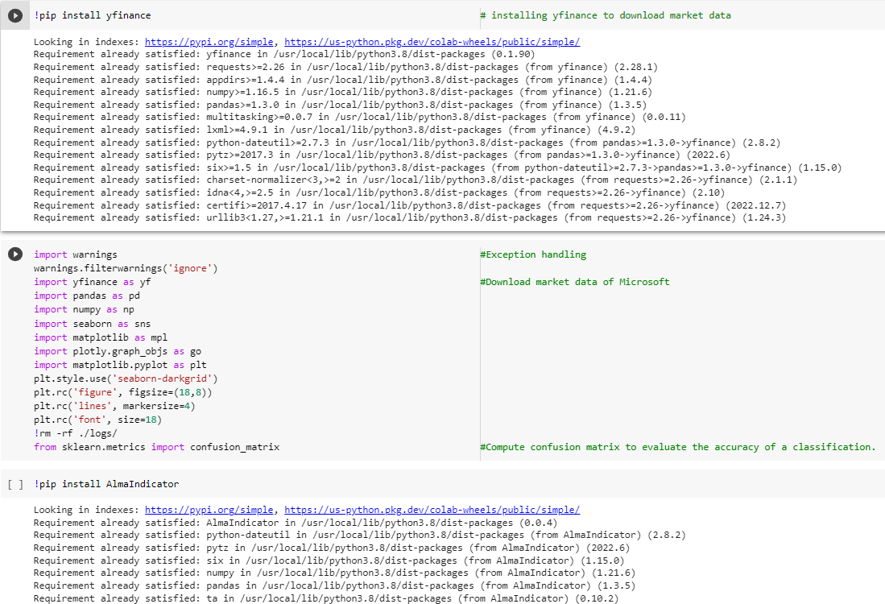
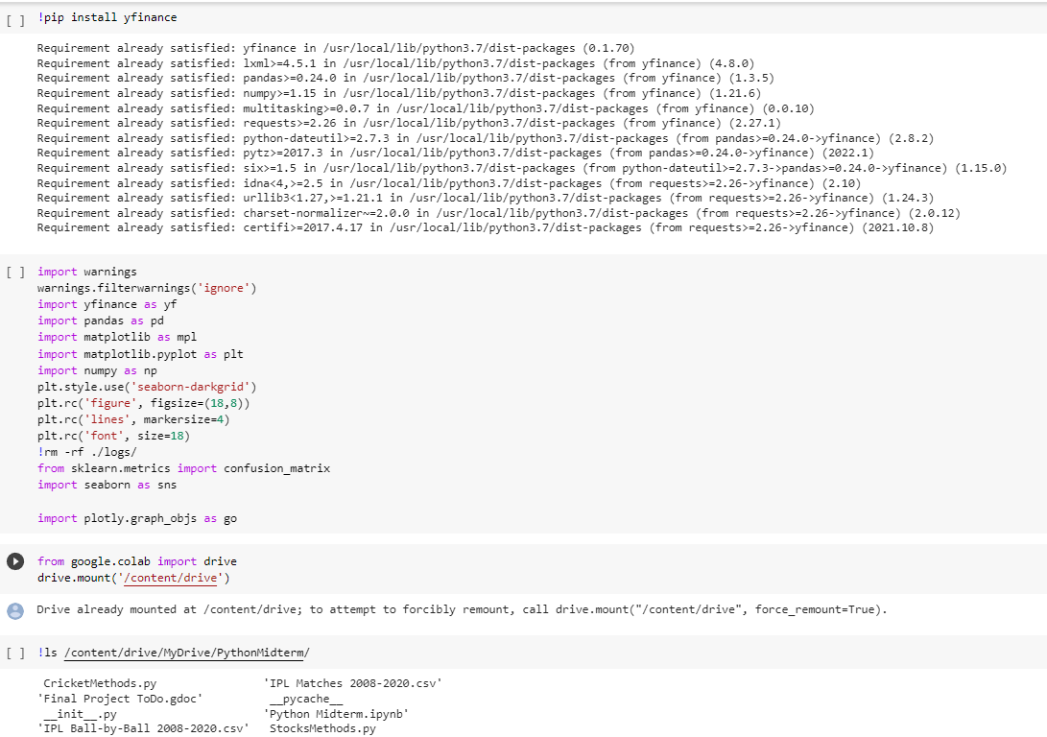
IMPORTING DATASETS AND LIBRARY
THIS PYTHON NOTEBOOK ANALYZES MICROSOFT STOCK MARKET PREDICTION BETWEEN 2012-01-01 to 2022-8-31 USING PYTHON TOOLS LIKE YFINANCE, PANDAS, NUMPY, MATPLOTLIB, SEABORN, AND PLOTLY
THIS PYTHON NOTEBOOK ANALYZES MICROSOFT STOCK MARKET PREDICTION BETWEEN 2012-01-01 to 2022-8-31 USING PYTHON TOOLS LIKE YFINANCE, PANDAS, NUMPY, MATPLOTLIB, SEABORN, AND PLOTLY

Slide 5

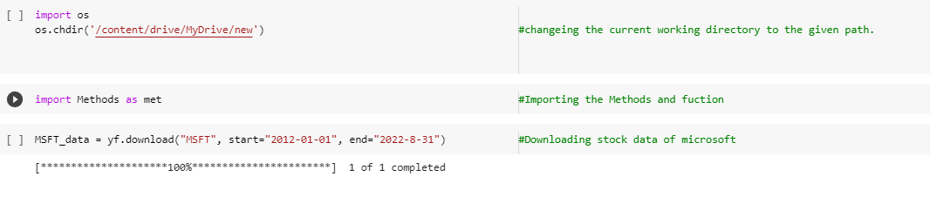
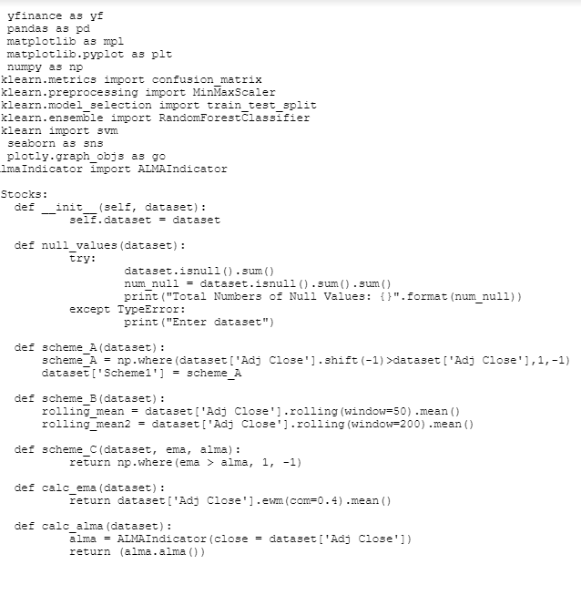
METHODS AND FUNCTIONS

Slide 6

EXPLORATORY DATA ANALYSIS (EDA)​
ALONG WITH THEIR RESPECTIVE VISUALIZATION

Slide 7
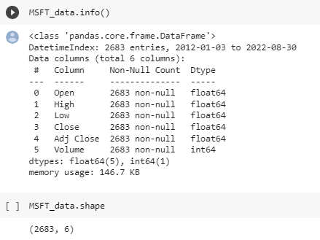
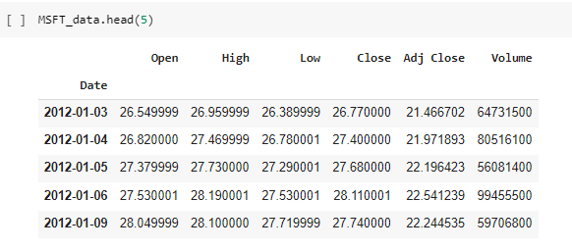
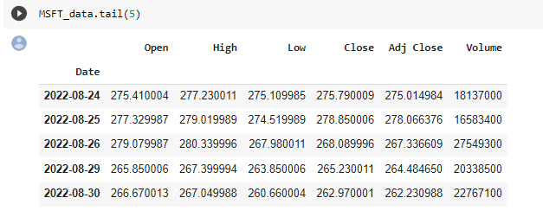
UNDERSTANDING THE DATASET

Slide 8
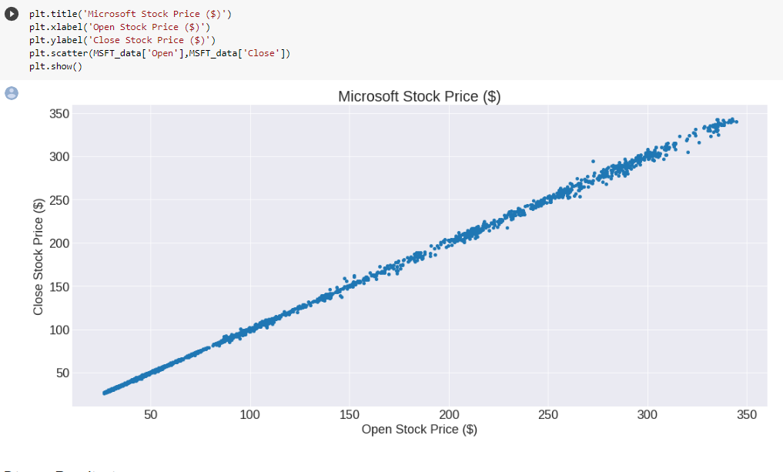
SCATTER PLOT
Scatter plot is used to compare two sets of data along the two axes. Here we have used it to show the relation between the open stock price and the close stock price.

Slide 9
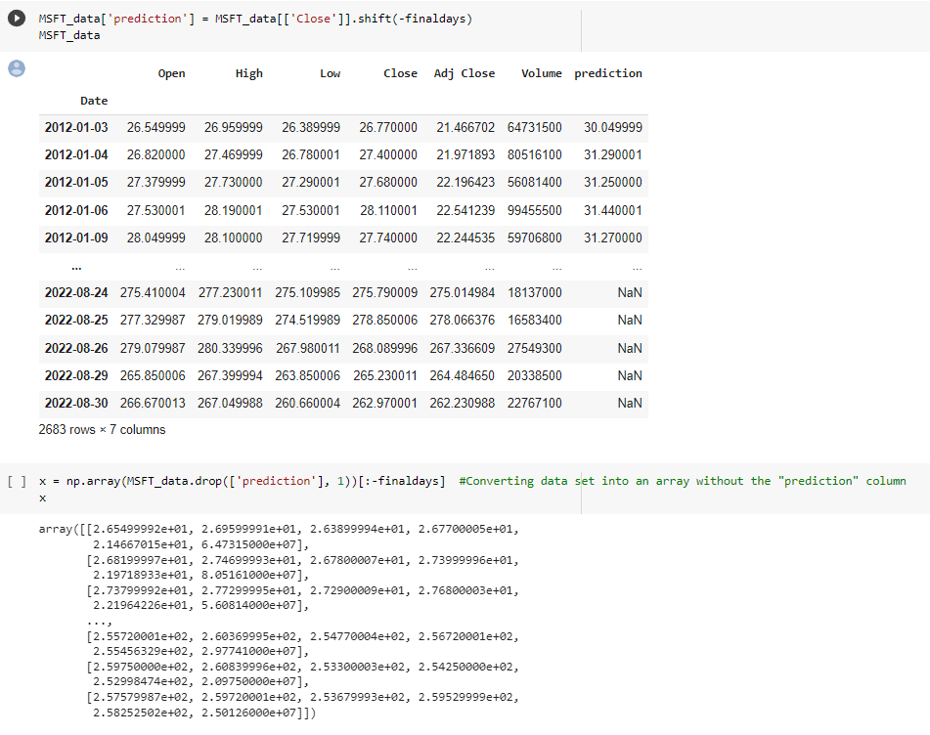
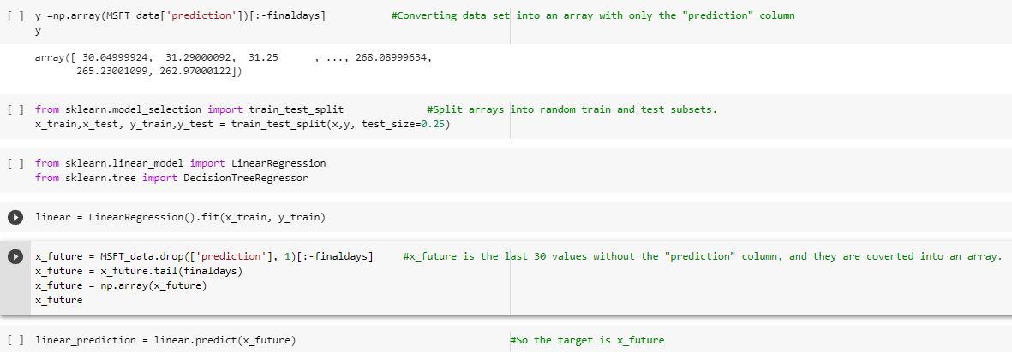
LINEAR PREDICTION

Slide 10
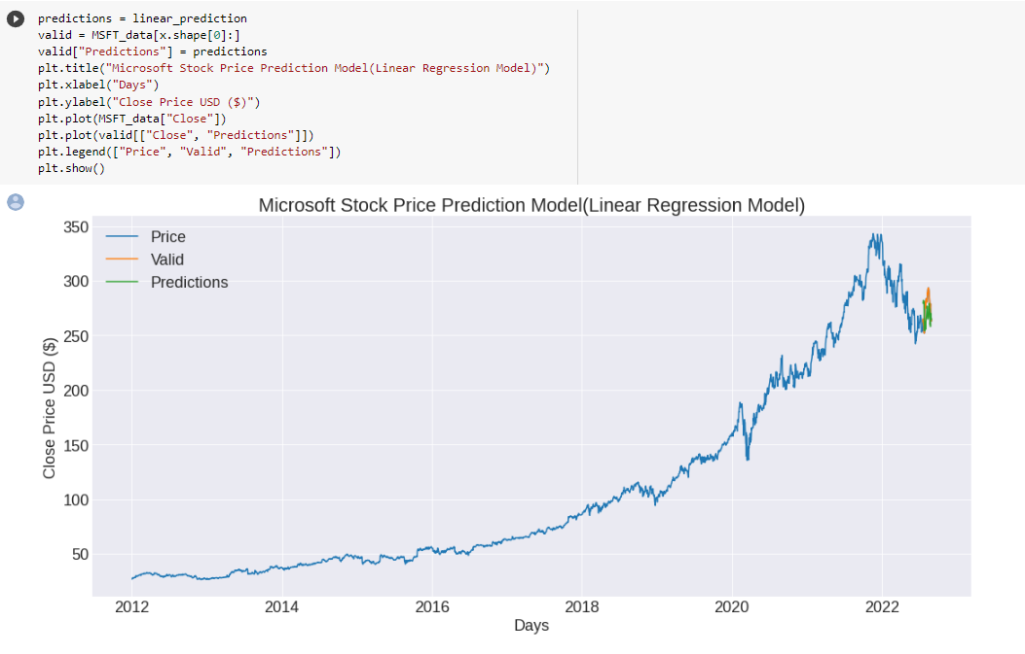
LINEAR PREDICTION VISUALIZATION
Linear regression is a statistical method used to model the linear relationship between a dependent variable and one or more independent variables. It is a type of supervised learning algorithm that is used to predict a continuous outcome based on a set of input features.

Slide 11
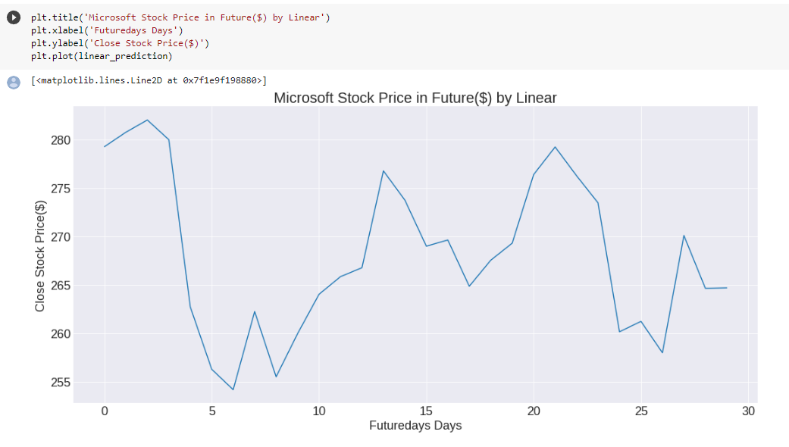
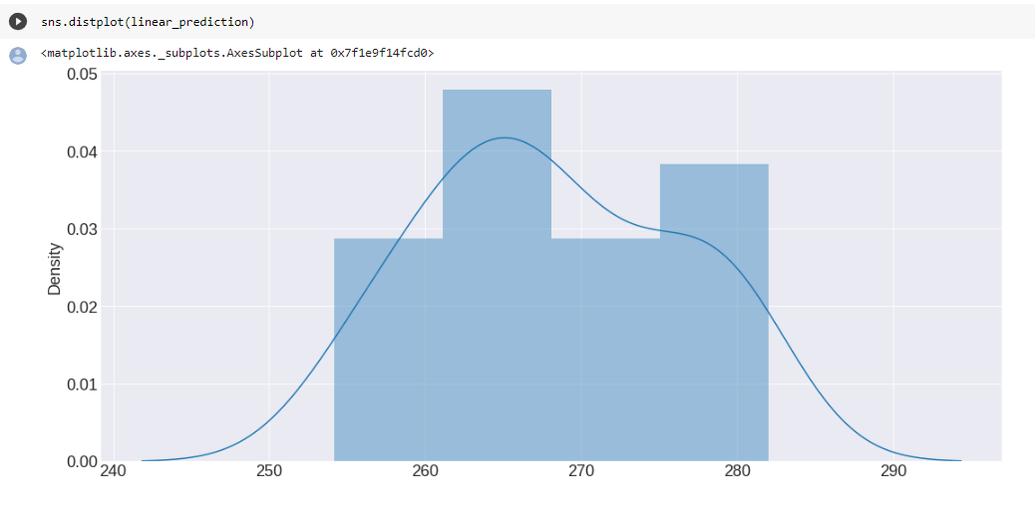
LINEAR PREDICTION VISUALIZATION

Slide 12

STRATEGY
We have used three methods to predict the more accuracy of Microsoft stock prediction
SCHEME 1
SCHEME 2
SCHEME 3

Slide 13
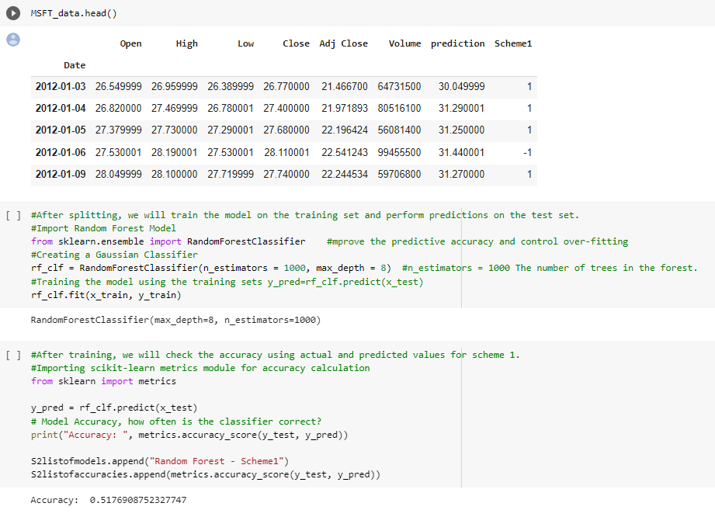

SCHEME 1
By using Scheme 1 we got 50% of Accuracy

Slide 14
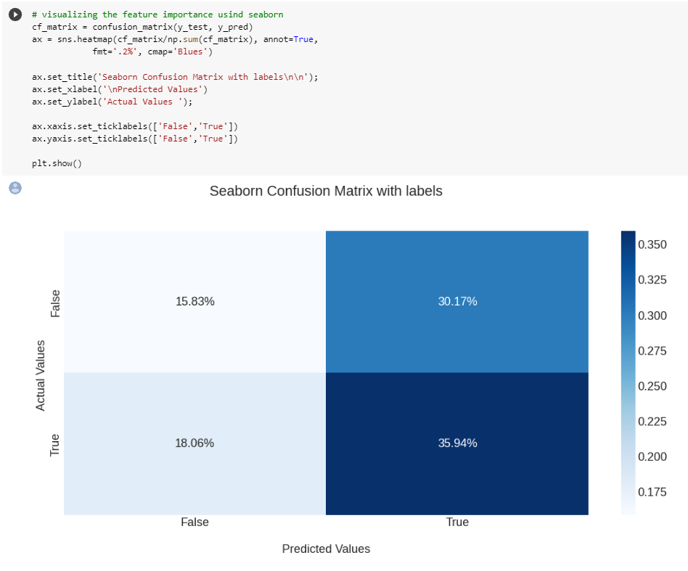
SCHEME 1 VISUALIZATION

Slide 15
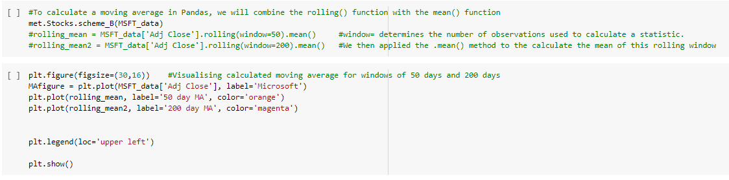
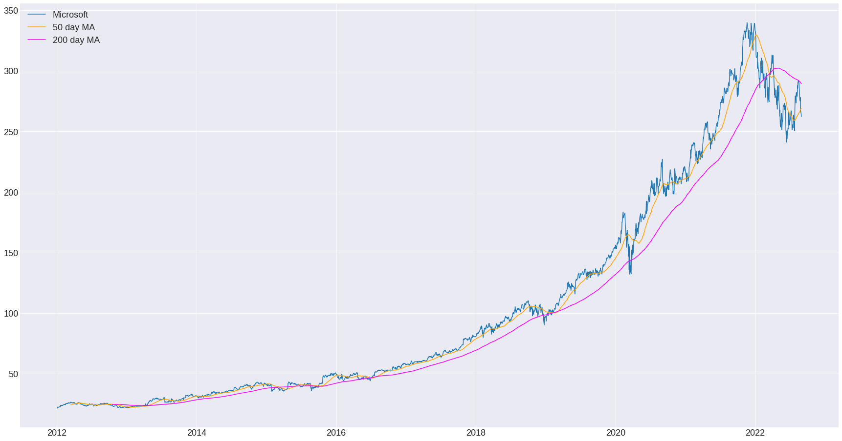

SCHEME 2

Slide 16
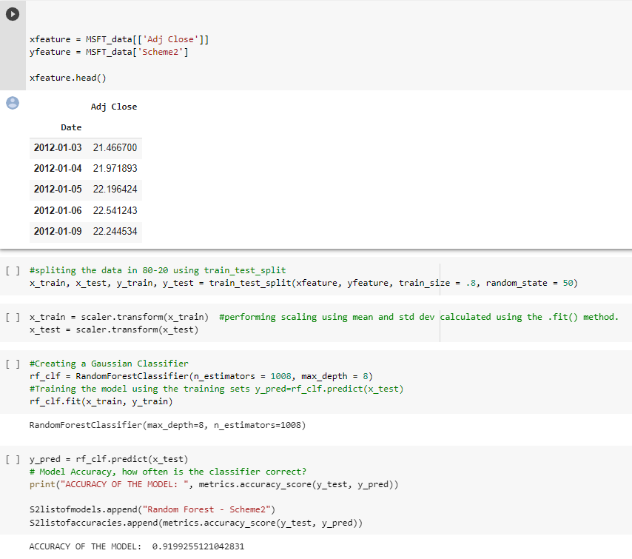
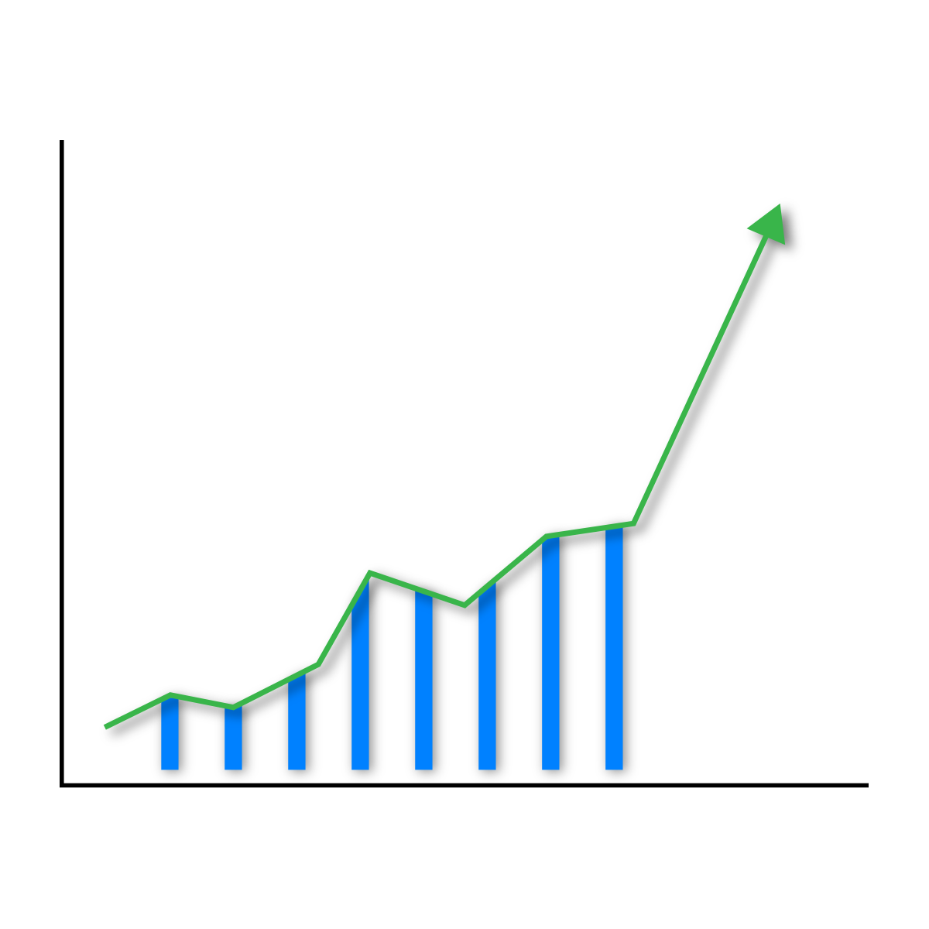
SCHEME 2
By using Scheme 2 we got 90% of Accuracy of the model

Slide 17
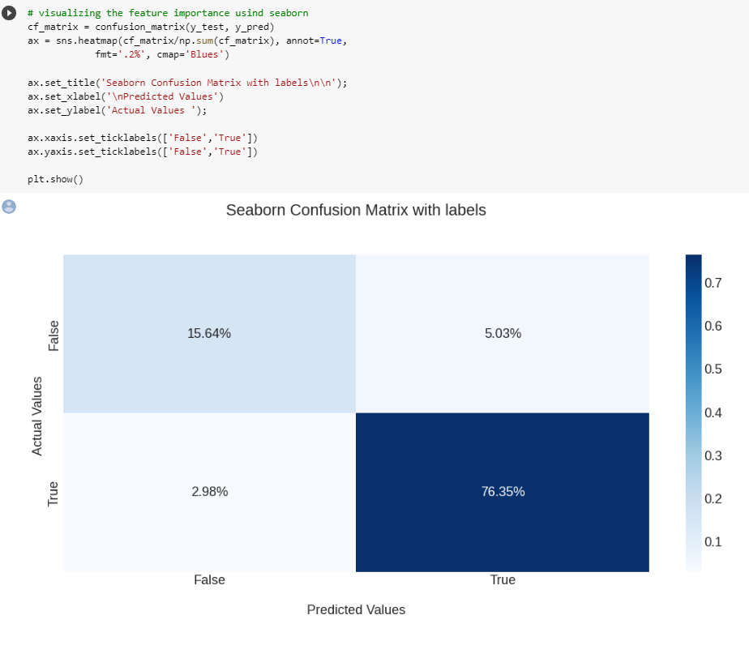
SCHEME 2 VISUALIZATION

Slide 18

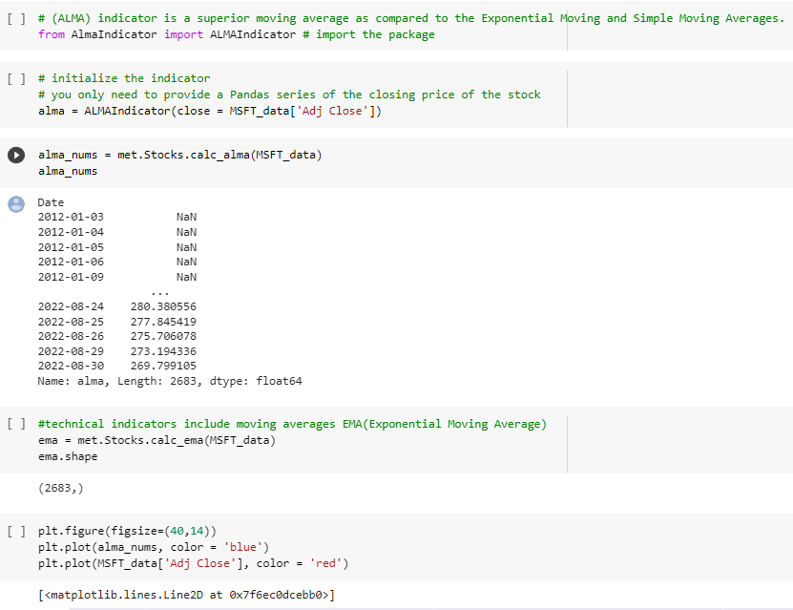
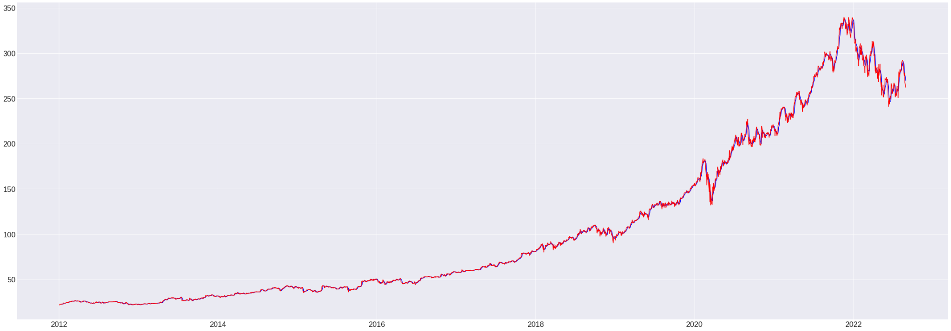
SCHEME 3

Slide 19
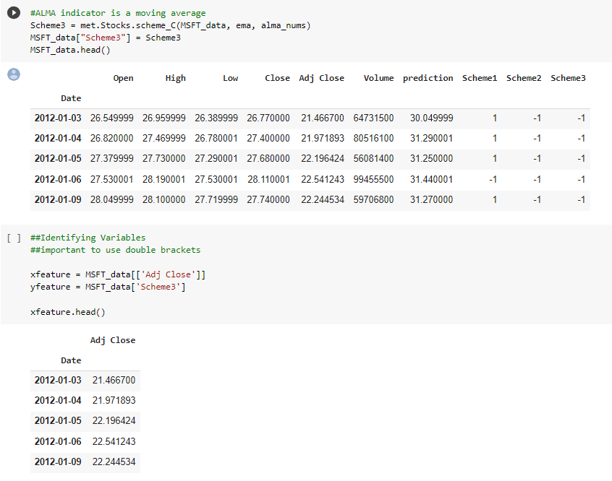
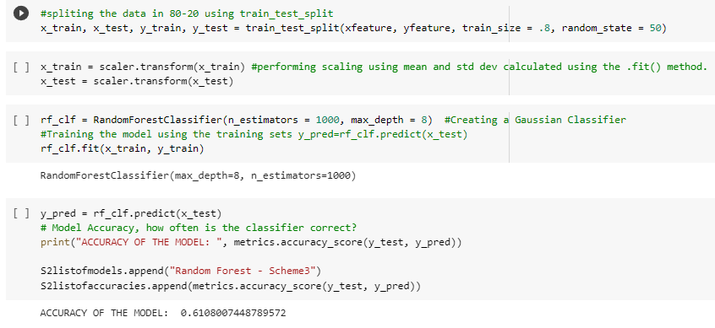
SCHEME 3
By using Scheme 3 we got 60% accuracy of the model

Slide 20
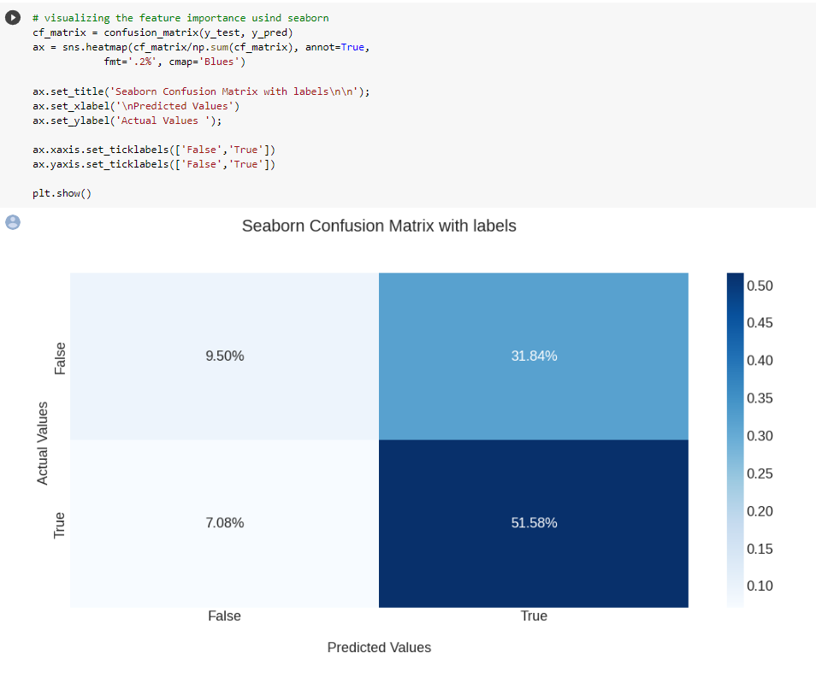
SCHEME 3 VISUALIZATION

Slide 21
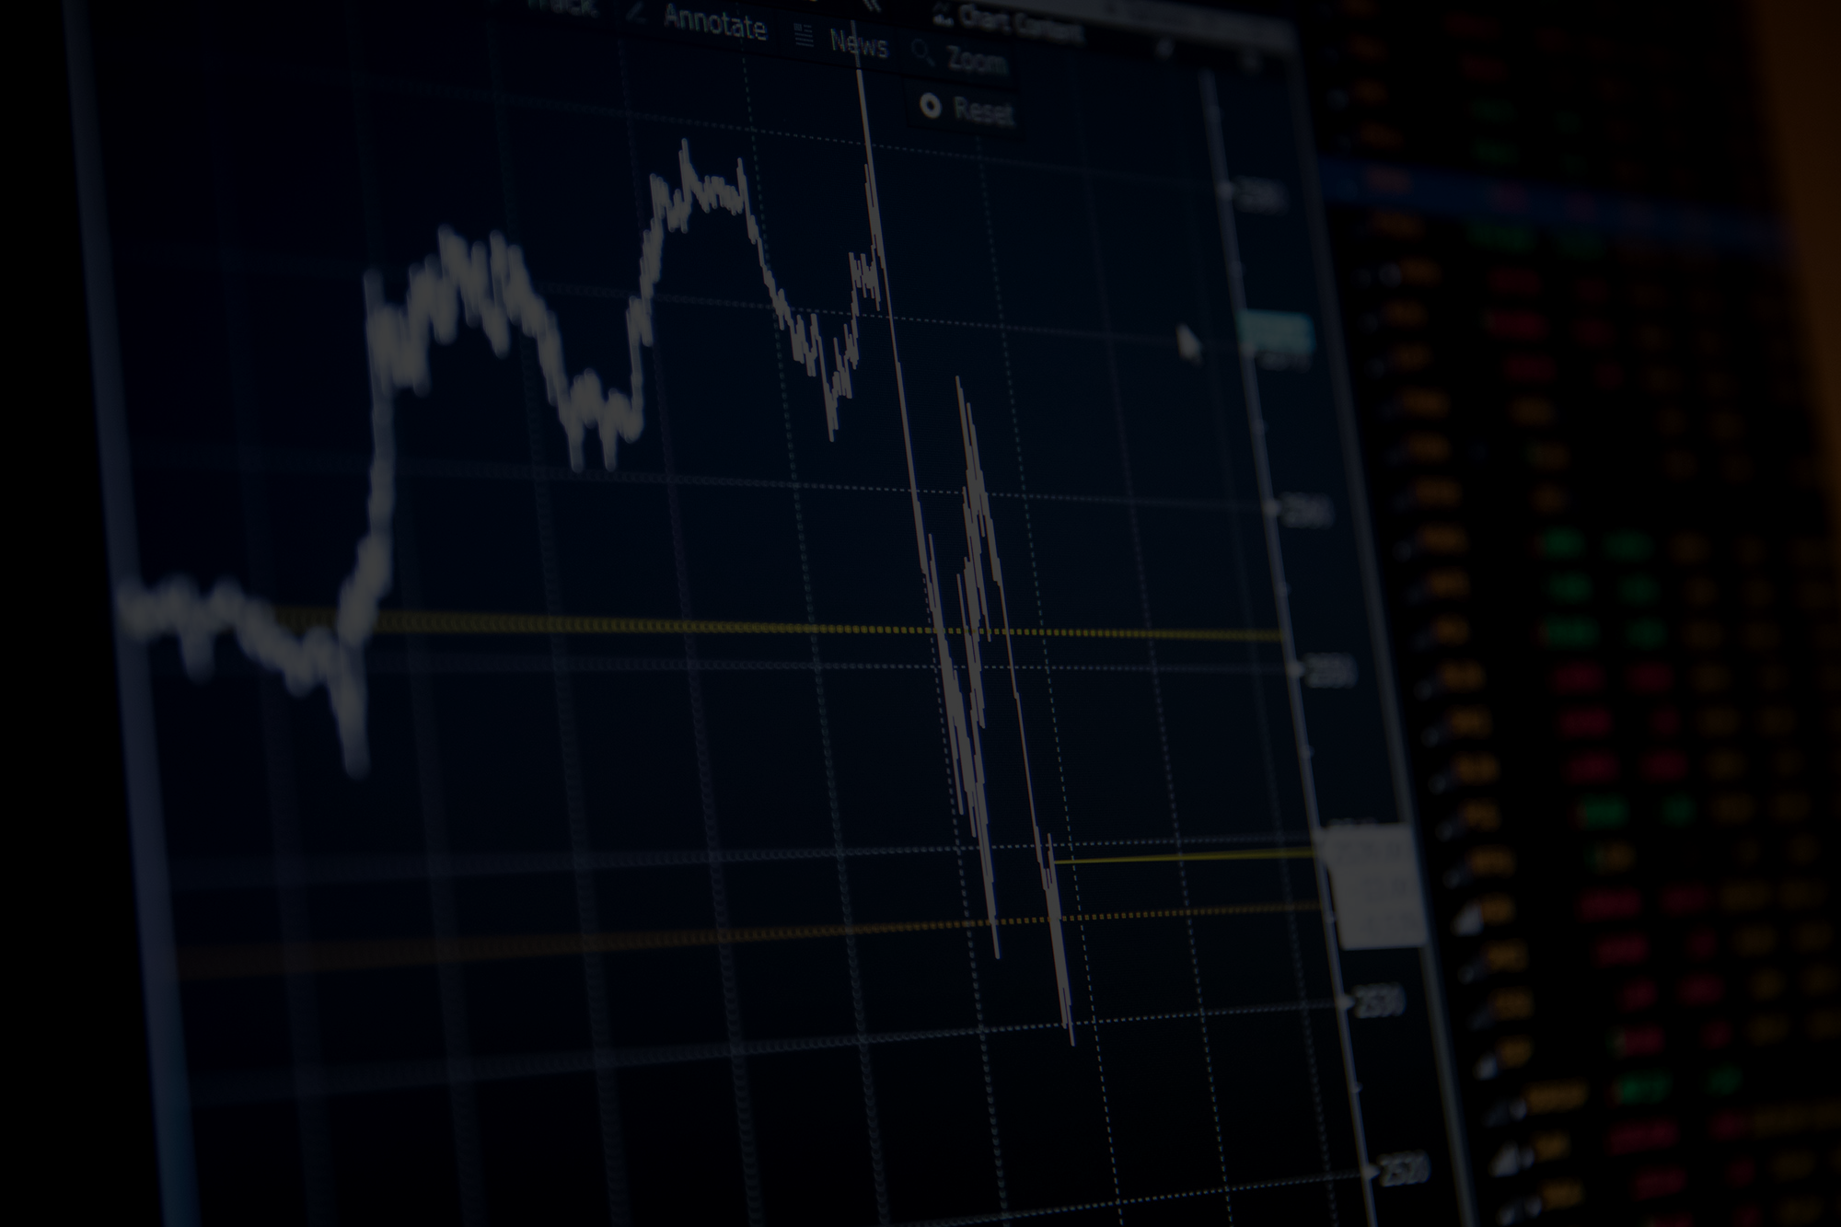
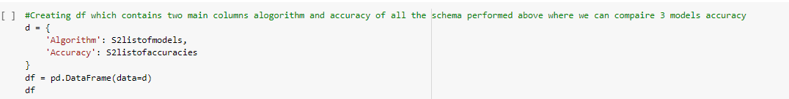
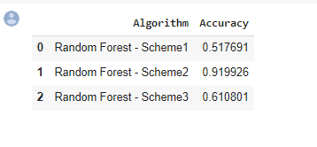
RESULT

Slide 22

CONCLUSION
While comparing all three models we got result of scheme 2 with accuracy of 92% which is most of all three schemes. So now we can use Scheme 2 in our future stock predictions to make it more precise and get good values out of it.

